Slide 1

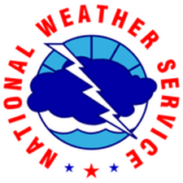
Hydrology and a NWS River Forecast Center…
Gregory Waller
Service Coordination Hydrologist
NWS – West Gulf River Forecast Center

Slide 2
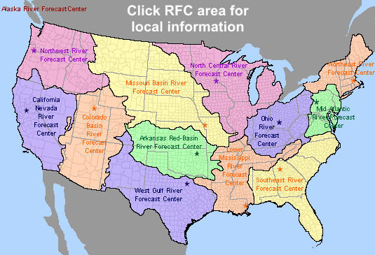
NWS River Forecast Centers
13 Offices (12 CONUS + 1 Alaska/Pacific)
Hydro-geologic boundaries
  Some modeling of headwaters in Canada/Mexico (no forecast services)
Daily Operations
  Data collection and quality control
  Precipitation and Hydrologic Forecasts
Project Activities
  New technologies
  New products

Slide 3
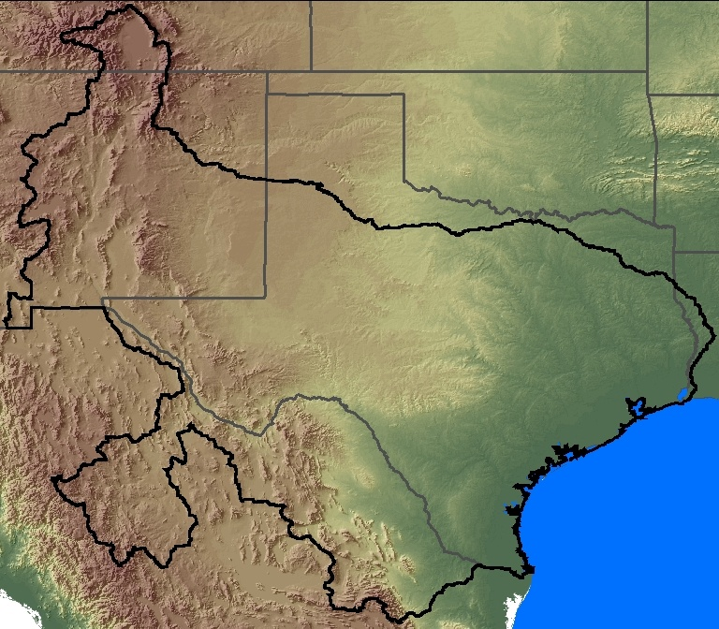
The WGRFC Area
Diverse Water Issues
402,000 mi² total area
87,000 mi² in MX (Rio Grande headwaters)
320 forecast points, 15 major river systems
Over 65,336 miles of rivers (U.S. only)
Snowpack Water supply
Complex reservoir operations
Hill Country Hydrology
Flash flood threats
Rapid river responses
Cycles of Flood/Drought
Prolonged river flooding
International Border – Water Allocation
Tropical cyclones
Storm surge
Coastal flooding

Slide 4

WGRFC Demographics
3 - Top 10 Metro areas in the U.S. (DFW Metro, Houston Metro, Austin/San Antonio Metro)
7 of Top 100 Fastest Growing Counties in the nation*: Hays, Fort Bend, Comal, Andrews, Montgomery, Williamson, Kendall
5 – Top 20 largest cities in the U.S.
There are over 6M people who speak Spanish in Texas. 2M people: Spanish is their only language.
Texas projected to double in population over the next 50 years**
*U.S. Census Bureau change from 2010 to 2011
**State of Texas – Office of the Demographer (2015)

Slide 5
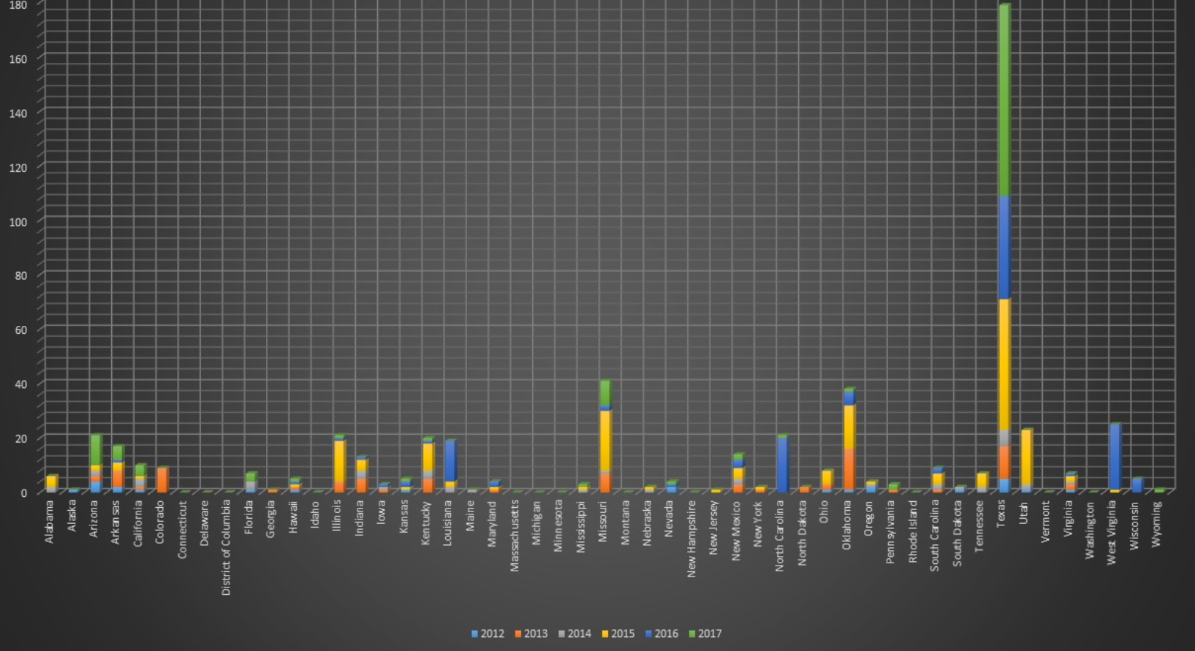
Perspective
Notes:
5 year tally of flood fatalities from the http://www.nws.noaa.gov/om/hazstats.shtml show Texas far outpaces all of the states in flood related fatalities

Slide 6
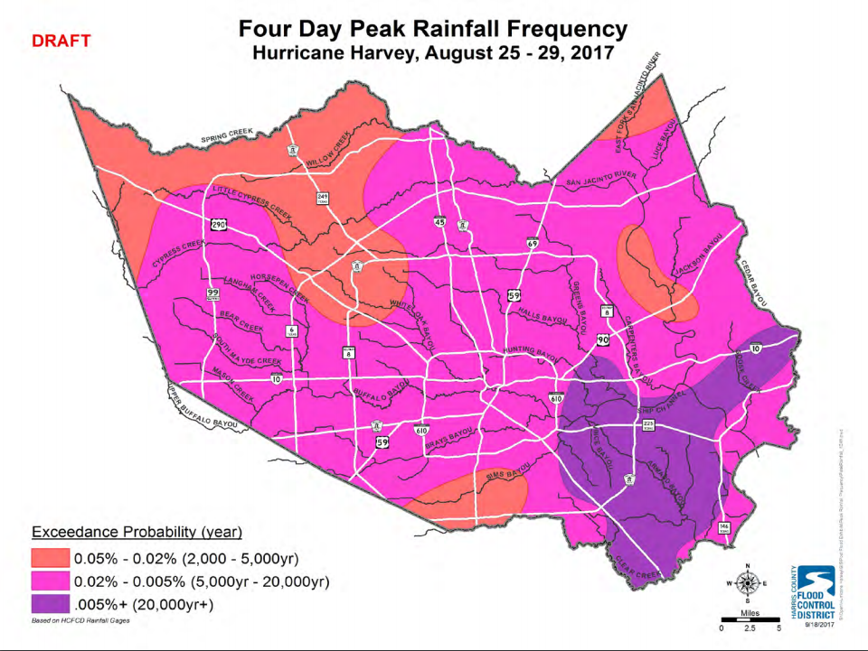
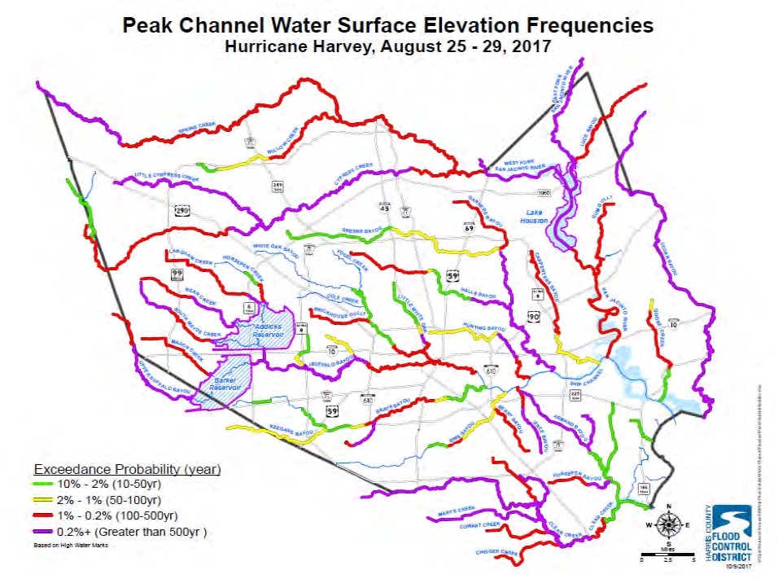
The Vocabulary
Public vs. “High End User”
Images courtesy of Jeff Lindner, Harris County FCD
Notes:
NWS does not use flood return periods or frequencies… it is too confusing to the public…

Slide 7
More Vocabulary
Flash Flood Emergency
  By definition, the NWS issues a “Warning” when conditions are life threatening → it could kill you
  But with the “Emergency”…this time I really mean it
Notice → “Flash Flood”
  Not river flood
NWS uses Minor, Moderate, Major, Record for river flooding
  Is that enough?
Steered away from “analogs”
  If you are expecting a record, something no one has ever seen, then how do you expect them to compare to a past event…
Notes:
NWS terminology…any “warning” is determined to be life threatening and it is occurring or imminent. NWS uses AHPS terminology to describe flooding

Slide 8
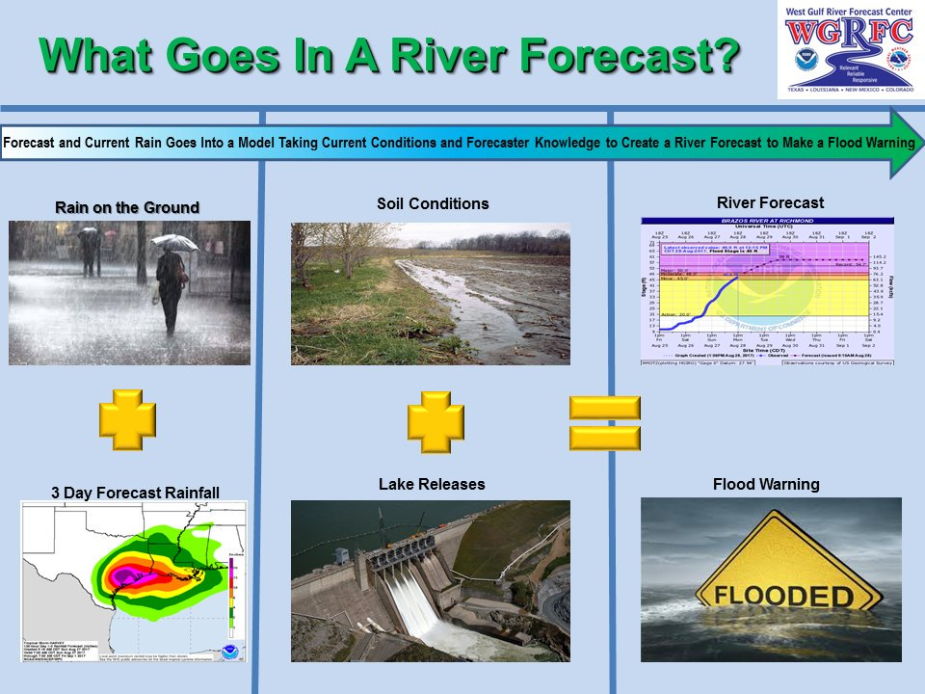
River Forecasting 101

Slide 9
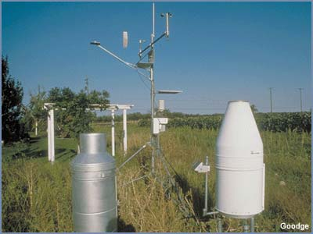
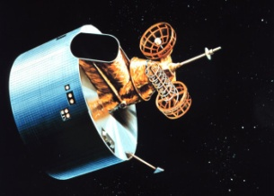
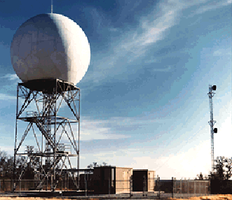
What is MPE?
Multi-sensor Precipitation Estimator
  Inputs
    Radar
    Gauges
    Satellite
  Final multi-sensor precipitation product is better than any single sensor.
Goals
  Reduce spatial inaccuracies and bias errors in rainfall datasets
  Produce a quality precipitation dataset for ingest into National Weather Service (NWS) hydrologic models

Slide 10
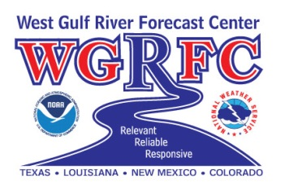
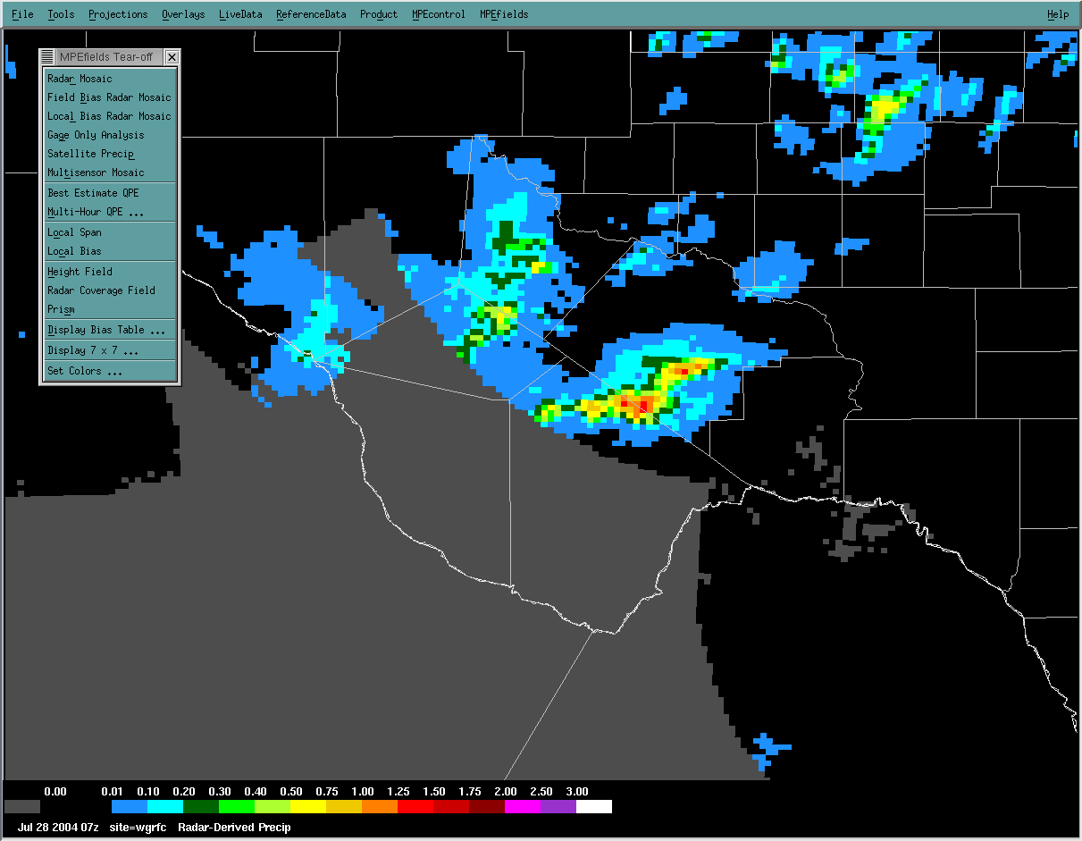
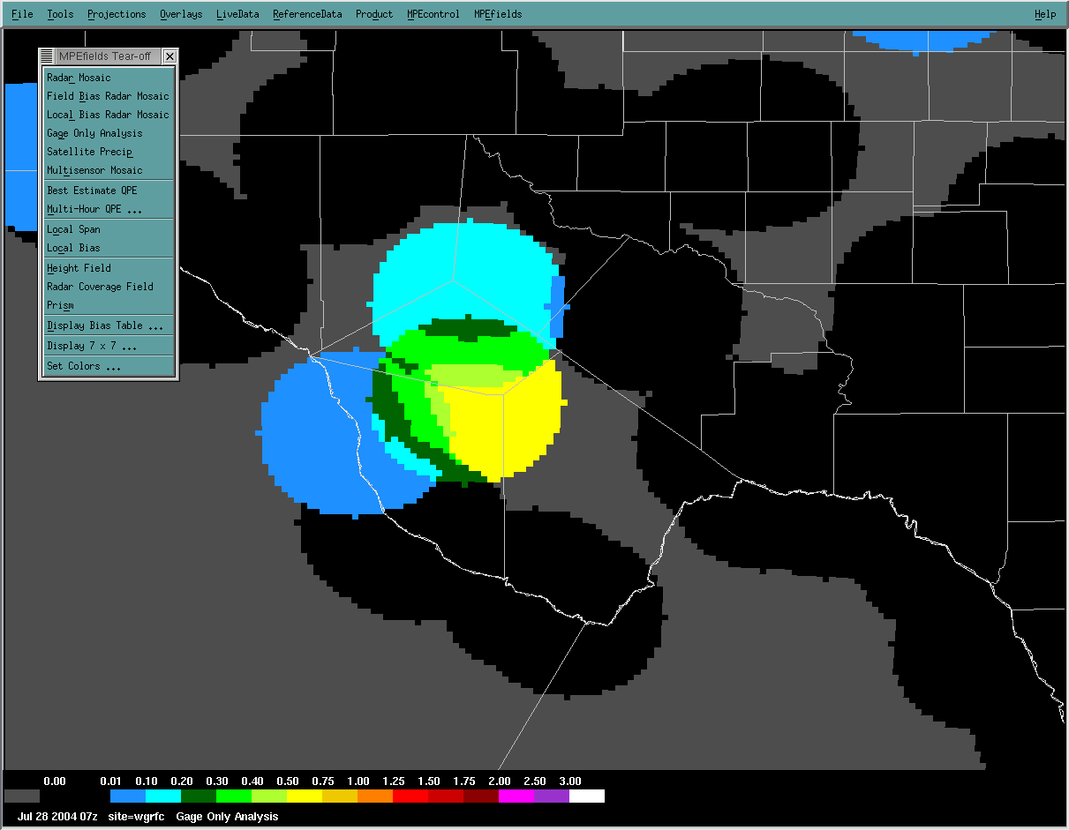
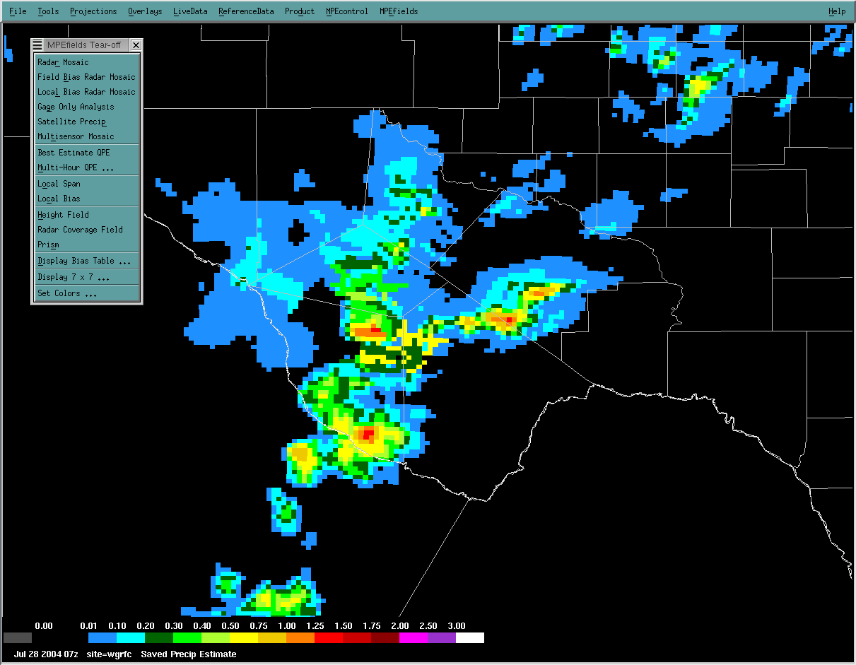
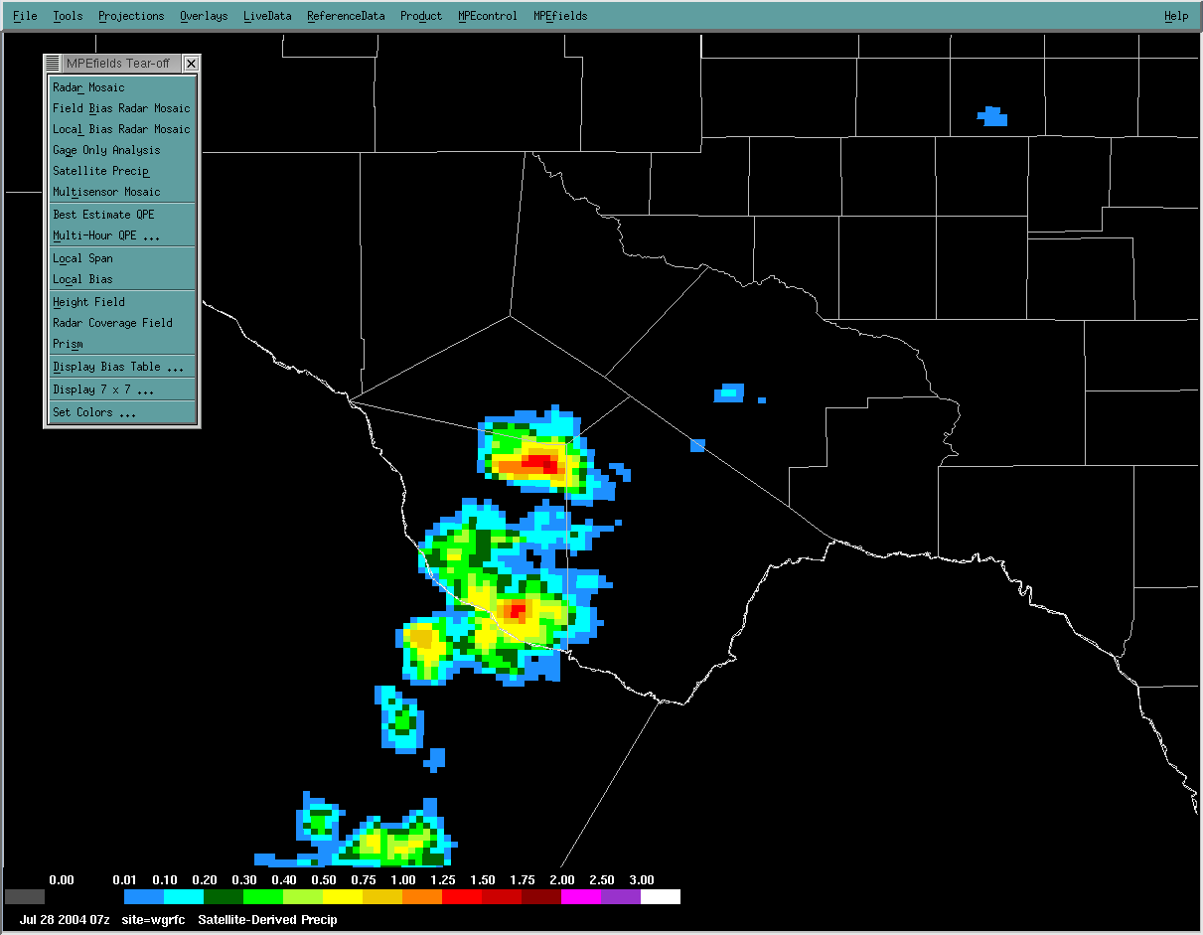
Precipitation Best Estimate
4km x 4km spatial resolution
1 hour temporal resolution
Human quality control of data inputs
Radar
Gauge
Satellite
Best Estimate (Multi-sensor Field)
Satellite

Slide 11
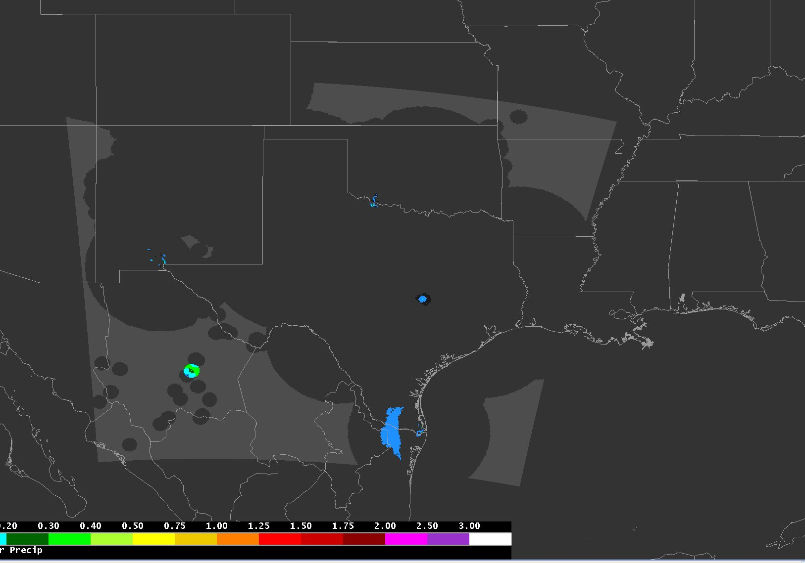
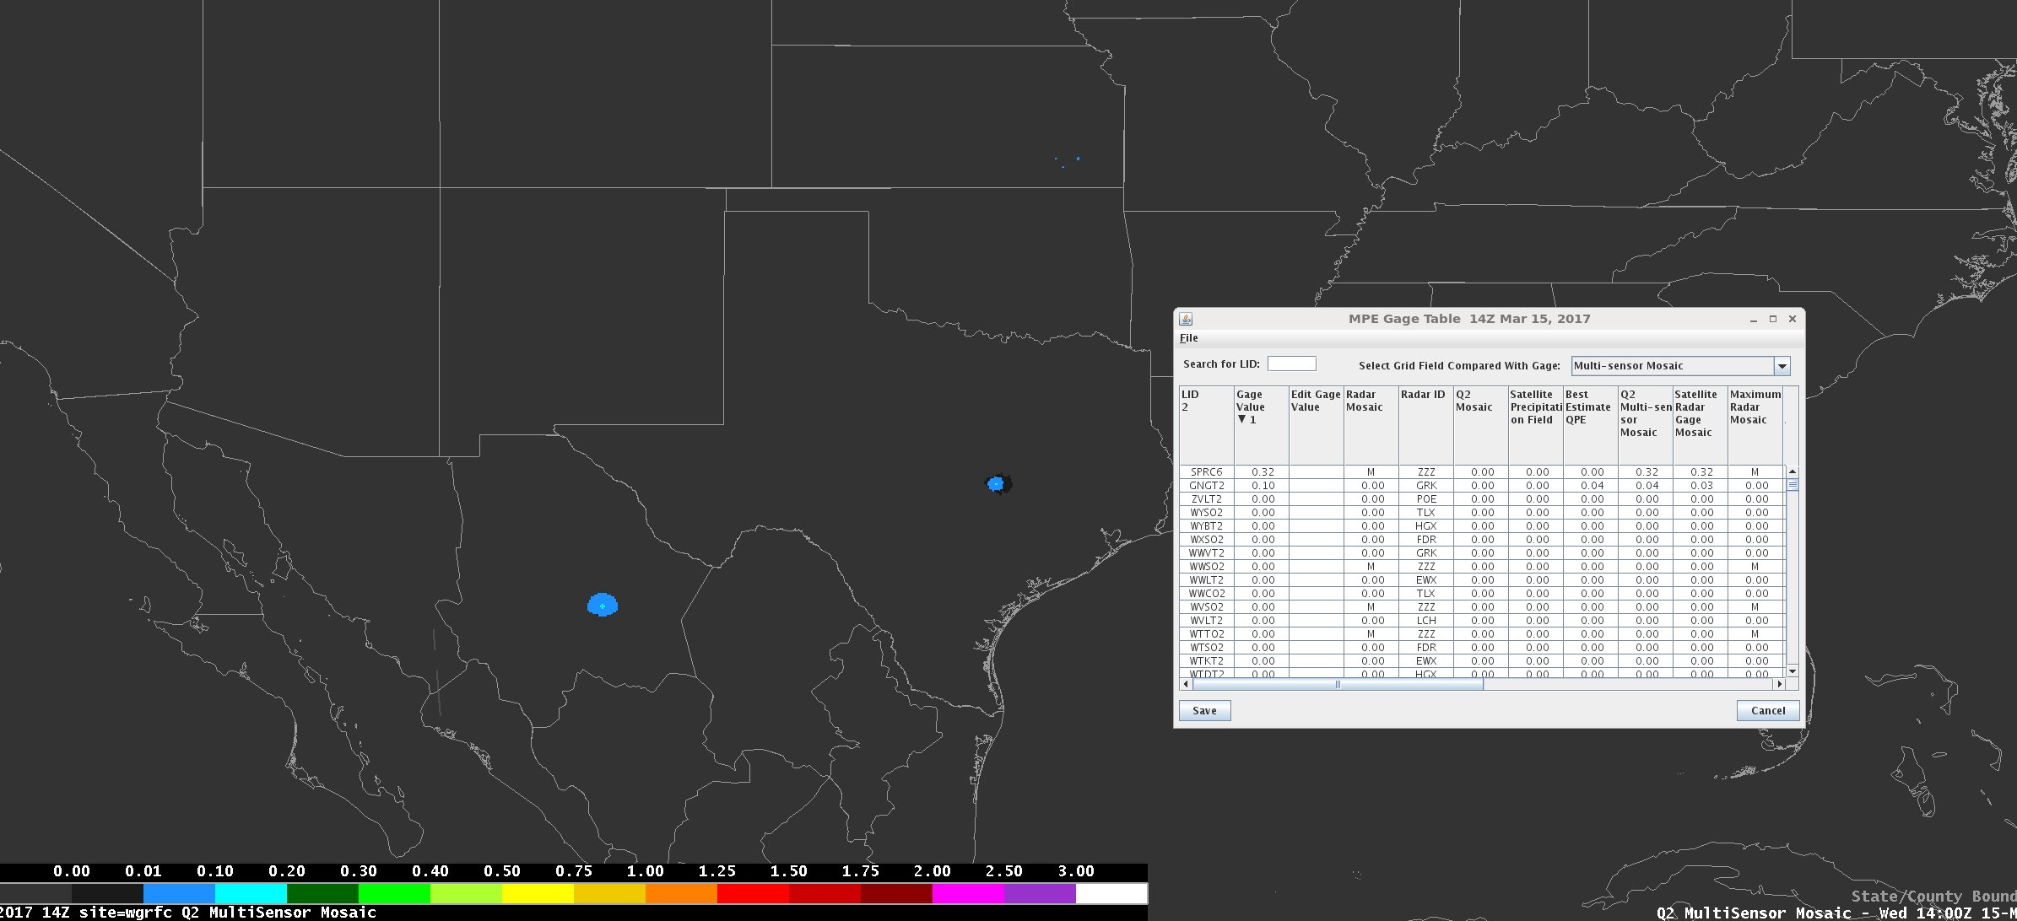
Radar vs MRMS
More Sensors → Better
MPE – Multi-sensor Precipitation Estimates
using regular radar
MPE using MRMS
Bad gages
AP

Slide 12
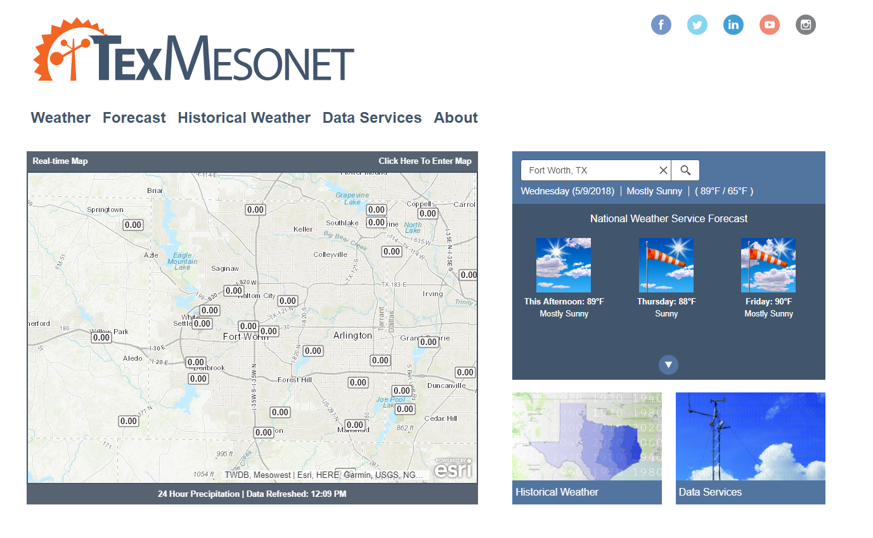
Texas Mesonet
More sensors → better spacing

Slide 13
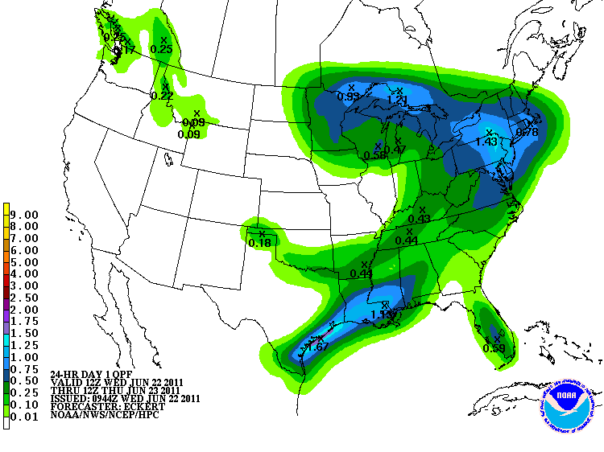
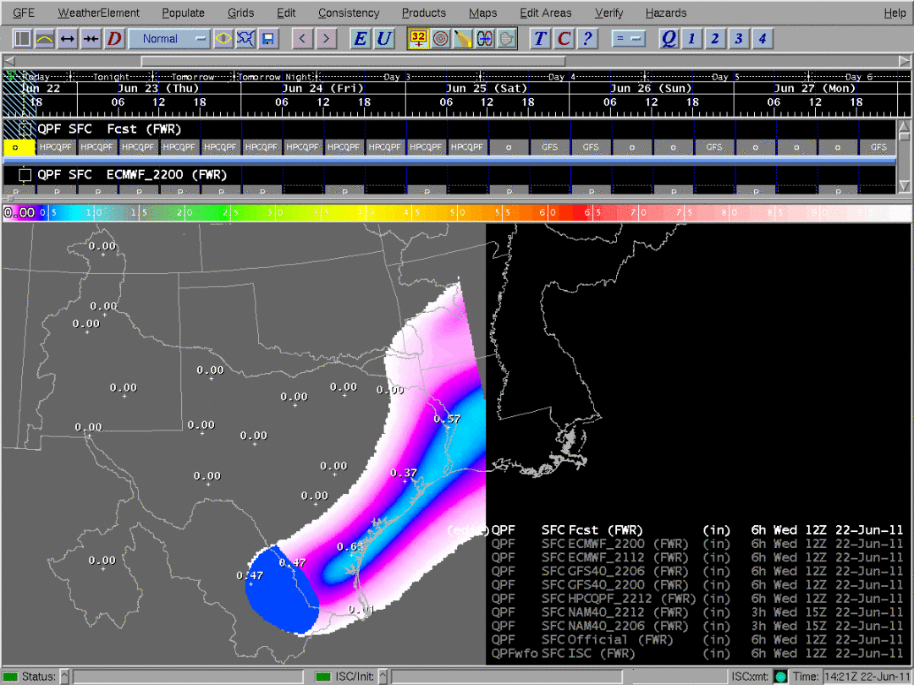
Precipitation Forecast/QPF
4 km x 4 km spatial resolution
6 hour temporal resolution
72 hours (12 periods) processed
  RFCs ingest 6-24 hours (1-4 periods) operationally in hydrologic models
  Additional periods ingested based on confidence in forecast
Guidance forecast issued by National Center
Forecaster at RFC makes adjustments based on local expertise

Slide 14
Hydrologic Forecast Process
A lot of estimates…
  Estimate how much rain gets into the river
    Rainfall to Runoff
  Estimate timing (how fast) of runoff to the river gage
    Unit Hydrograph
  Estimate how fast any upstream water arrives at the gage
    Routing
  Estimate water flow (we use) into water height (the public uses)
    Rating
We can modify any/all of the above

Slide 15
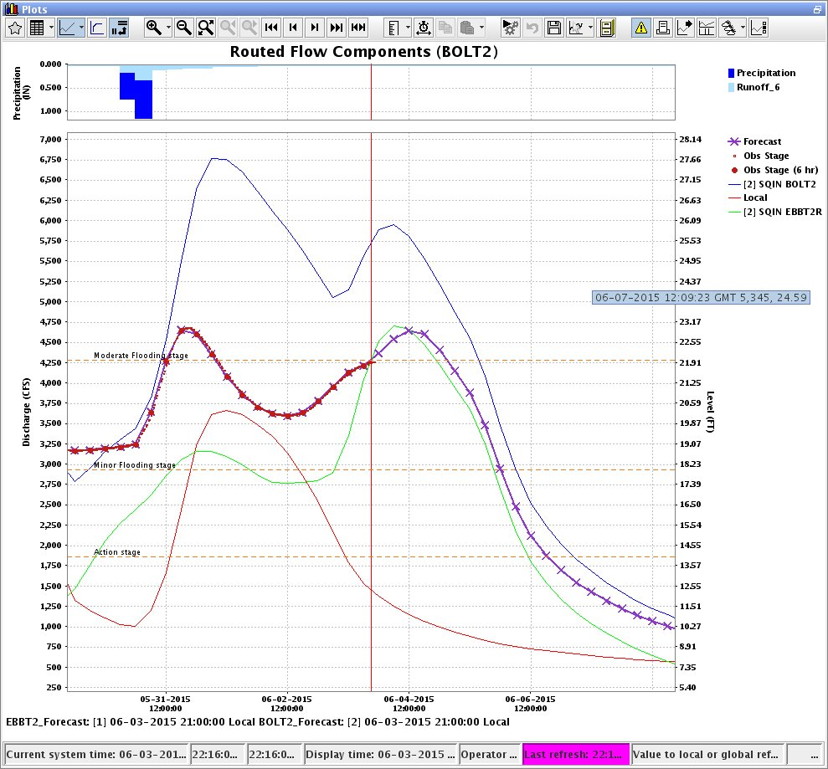
The Result – Our Model

Slide 16
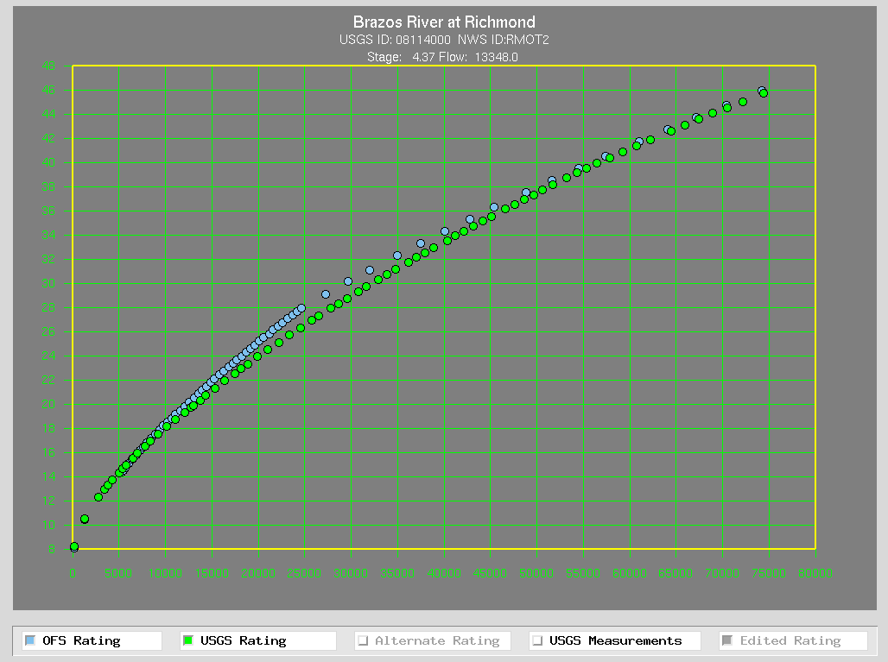
Rating Curve - Flow vs Height

Slide 17

Hydrograph Basics
LOCATION: Of the gage the forecast is made, AT means the gage is in the limits of the town/city, NEAR or NR means that town/city has the closest post office
STAGE VS FLOW: Hydrologists, models, reservoirs work in flow. Emergency managers, media, general public work in stage…sometimes
What is flow or a cubic foot per second?
A basketball is roughly a cubic foot, so 20,000cfs is 20,000 basketballs of water passing the gage every second.
The USGS measures the flow and the stage at every gage and provides a rating curve linking the two units.
OBSERVED: Last 3 days of observations from USGS with the latest observation noted
FORECAST: 5 Day forecast for site that is updated every 6 hours

Slide 18
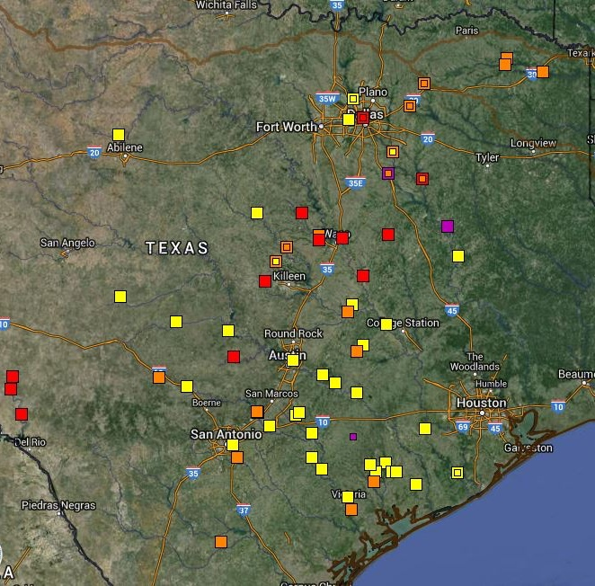
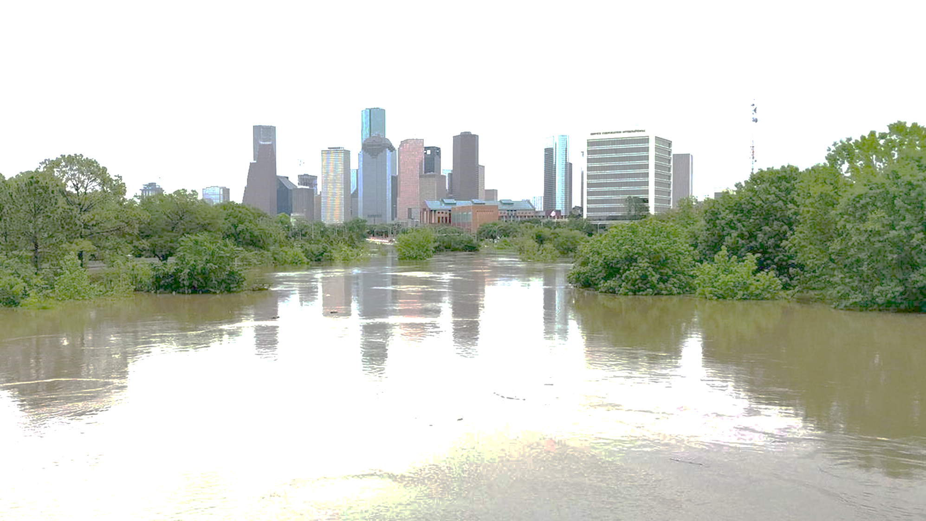
BELOW CRITERIA
Impact: Water is within the banks of the river with no impacts to the surrounding area. Flow speeds may still be high during rainfall or releases which could impact recreational activities
ACTION
Impact: Water is over the banks and into the flood plain, but not a threat to structures or roadways. Some action may be required such as moving farm equipment or increasing awareness
MINOR
Impact: Typically water is impacting areas inside of flood plain which can vary by location. Some low water crossings covered by water, agricultural flooding, water approaching public areas (parks, sidewalks etc.). Areas frequently flooded can expect to be impacted
MODERATE
Impact: Water now reaching areas only impacted by significant rain events. Structures can be inundated, several roads covered with water, water may cut off certain areas, widespread agricultural flooding
MAJOR
Impact: Water is near the highest its ever been representing rare flooding and significant widespread impacts. Most roads will be covered by water in the area cutting off if not completely flooding subdivisions, rivers can be several miles wide in areas. Homes and structures underwater, bridges inundated and in danger of being hit by debris. Impacts may be greater than ever experienced.

Slide 19
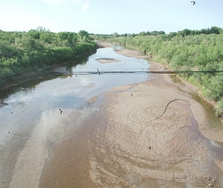
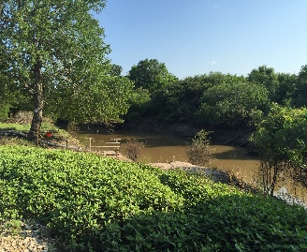
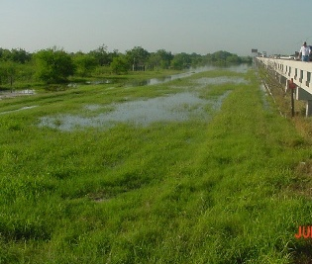
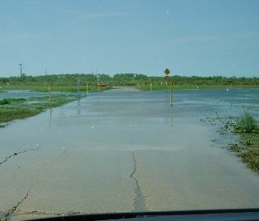
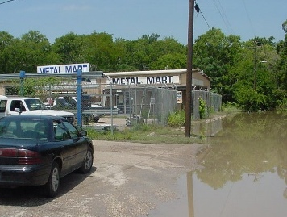
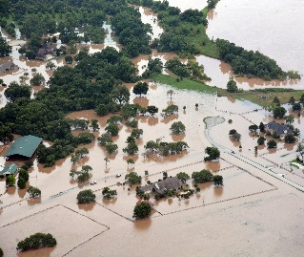
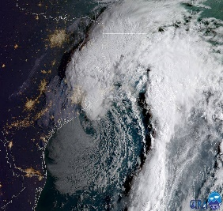


Understanding River Forecast Categories
Low Flow
No Flooding
ACTION STAGE
(AS)
MINOR
(MIN)
MODERATE
(MDT)
MAJOR
(MAJ)
RECORD
(REC)
Impacts to water supply and intake/outflow structures
River is within banks, no impacts
River is higher, possibly out of banks
Impacts to secondary roads and lowlands near floodplain
Buildings threatened, roads flooded and impassable
Significant impacts to buildings, structures and roadways
Impacts beyond anything previously experienced
Flood Warnings, River Forecasts
Flood Warnings, River Forecasts
Flood Warnings, River Forecasts,
Flood of Record Statements
Only daily operational points will have forecasts available
Only daily operational points will have forecasts available
Flood Statements, River Forecasts Begin
Flood Warnings, River Forecasts
SIGNIFICANT FLOODING
• Agriculture industry will have to prepare
• Reservoir levels for water storage monitored
• River can be running higher than “normal” so caution should still be used
• Higher flows
• River could be out of banks
• Turn around don’t drown!
• Stay away from river’s edge as flow speeds could be high
• Turn around don’t drown!
• Homes and buildings could be cut off as well and should prepare
• Evacuations may be necessary
• Seek higher ground
• Potentially safer to shelter in place
• Seek safety or higher ground by any means
• Impact areas should be avoided
* NWS generally defines a river flooding as the point at which higher flows produce impacts. Common impacts are road closures, parks inundated, and water in structures. River flooding does not have to be associated with other flood threats (flash, areal, coastal).
National Weather Service
www.weather.gov/wgrfc

Slide 20


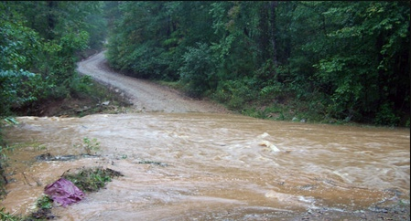

Understanding Flooding
Created March 8th 2015 @ 1:30pm CST
West Gulf River Forecast Center
NWSWGRFC
@NWSWGRFC
Urban / Small Stream Advisory issued when flooding of small streams, streets and low-lying areas, such as railroad underpasses and urban storm drains, is occurring or is imminent. | Flood Watch issued when flooding is possible – typically within a 6 to 48 hour time frame before the event. | Flash Flood Watch issued when flash flooding is possible. Flash Flood Watches are generally issued for flooding that is expected to occur within 6 hours of the event, which could be heavy rainfall or a dam /levee failure. | Flood Warning issued when flooding conditions are actually occurring or are imminent. | Flash Flood Warning issued when flash flooding is actually occurring or imminent. Flash Flood Warnings are issued for short-term events, which require immediate action to protect lives and property. | Flash Flood Emergency issued for a flash flood situation that presents a clear threat to human life due to extremely dangerous flooding conditions. This signifies an area that is witnessing record flash flooding.
How is a flash flood different from a standard flood?
Flash floods are characterized by rapid and heavy precipitation over a short period of time (typically less than 6 hours) or levee/dam failures. These can lead to raging water that can rip through river beds and damage urban infrastructure.
Flooding Can Happen Anywhere. Are you “Flood Prepared”?
Be Flood Aware. Turn Around. Don’t Drown!

Slide 21
Lather, Rinse, Repeat
Multi-day events
Routine 6 hourly updates
  Will update as required between 6 hour intervals
Factor in variables provided by partners
Coordinate some more…
The skinny line on a graph is NOT enough!

Slide 22
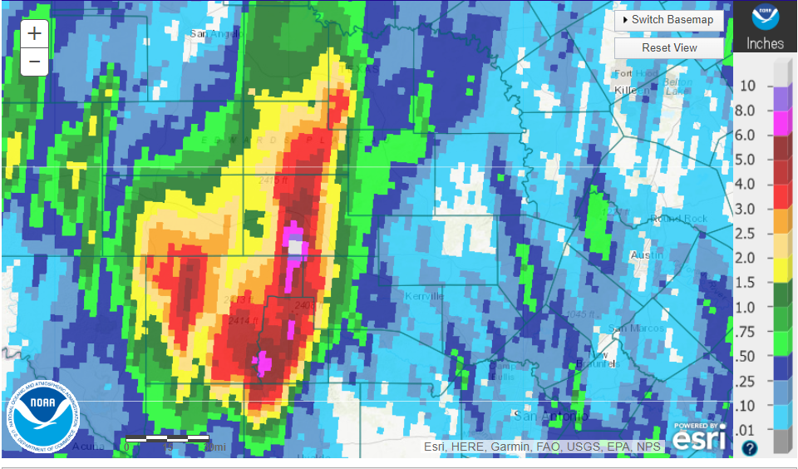
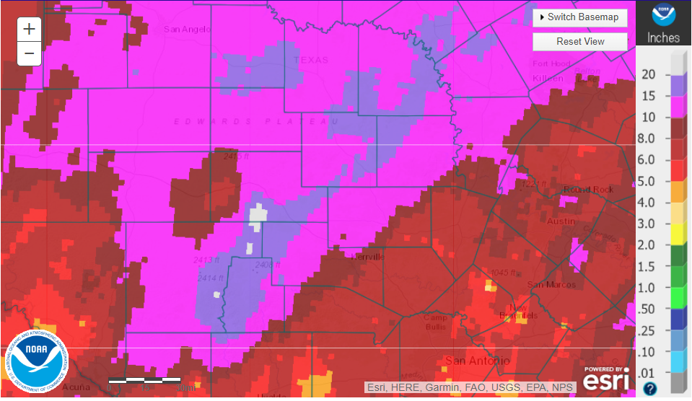
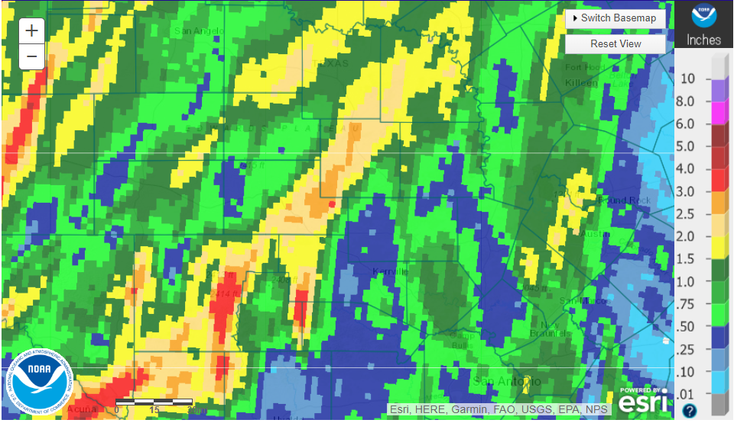
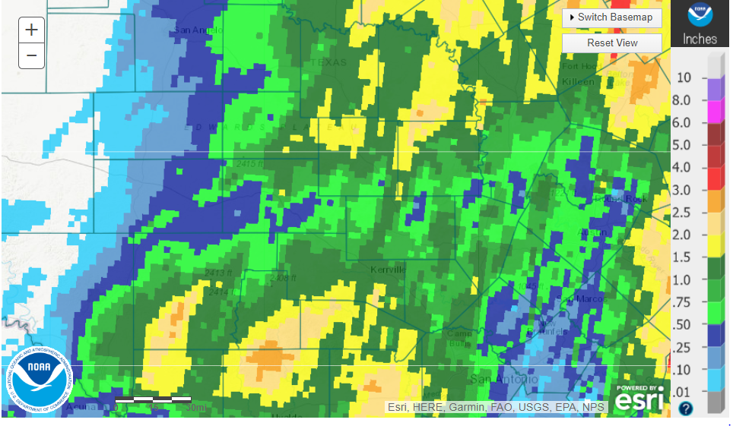
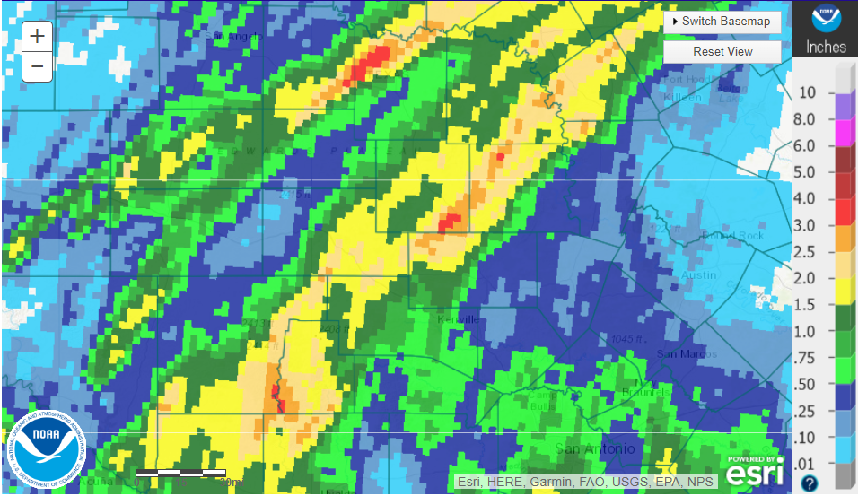
The Set Up…

Slide 23
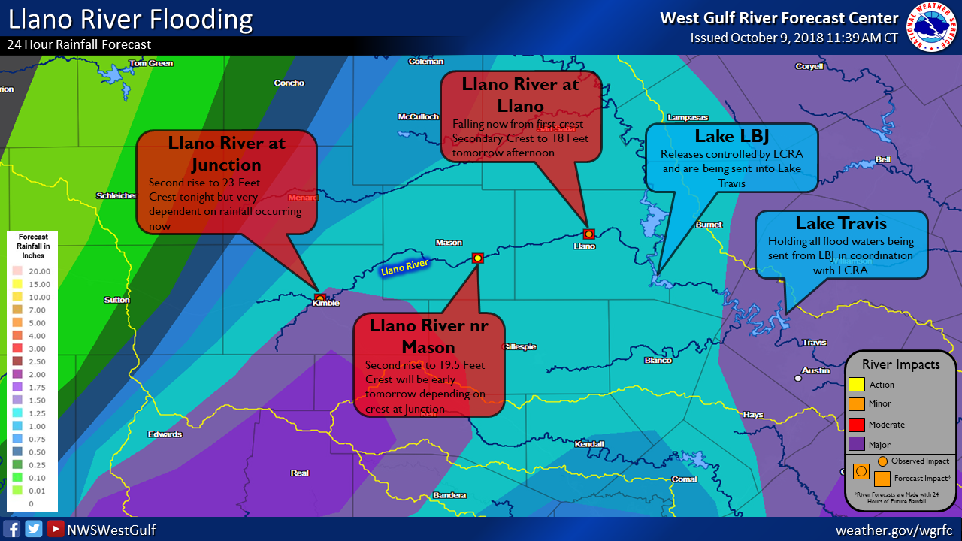
Llano 2018 Briefings

Slide 24
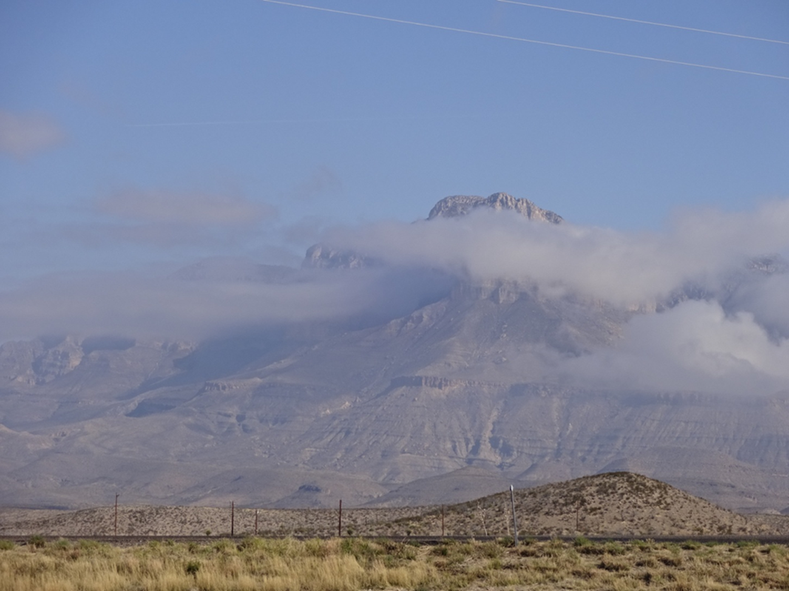
Questions/Comments?
Gregory Waller
Service Coordination Hydrologist
NWS West Gulf River Forecast Center
greg.waller@noaa.gov

