Slide 1
Grazing Management after Fire and Drought
Kason Haby
Rangeland Management Specialist
Edwards Region Grazing Lands Conservation Initiative
Notes:
As cattlemen we are actually grass farmers. How can we grow more grass from the same amount of land to produce more beef. The answer is through Grazing Management. We have to learn how to manipulate grass so that it is more productive.

Slide 2
Concerns after a Fire, during a Drought or Both!
When will it rain?
How much will it rain?
What if it does not rain?
How much should I reduce stock?
What are the consequences of overstocking?

Slide 3
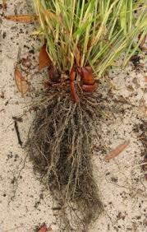
Notes:
Plants need sunlight and use leaves to capture it for energy to grow more leaves and roots; excess energy is stored as Carbohydrates in stems, base, roots.
Most plants are tolerant or adapted to fire and survive and respond well after fire under low to moderate fire intensity with adequate soil moisture. In extreme circumstances like the Oasis pipeline fire soil moisture was low and fire intensity was extreme which allows the basal buds of the plants to reach a temperature (140F) they can’t tolerate. This was the perfect recipe to kill grass and forbs and severely hurt brush and trees. Since most brush and trees besides ahse juniper have bud zone below ground these plants are able to use stored energy to resprout even though the aerial buds are dead.

Slide 4
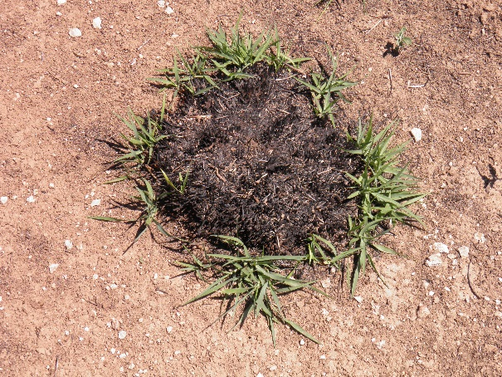
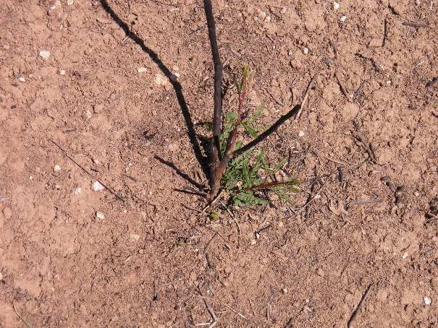
Fire & Drought Impacts on Plants
When fire intensity is extreme and soil moisture is low:
Above ground buds are killed
Grasses and Forbs die
Brush and Trees may re-sprout

Slide 5
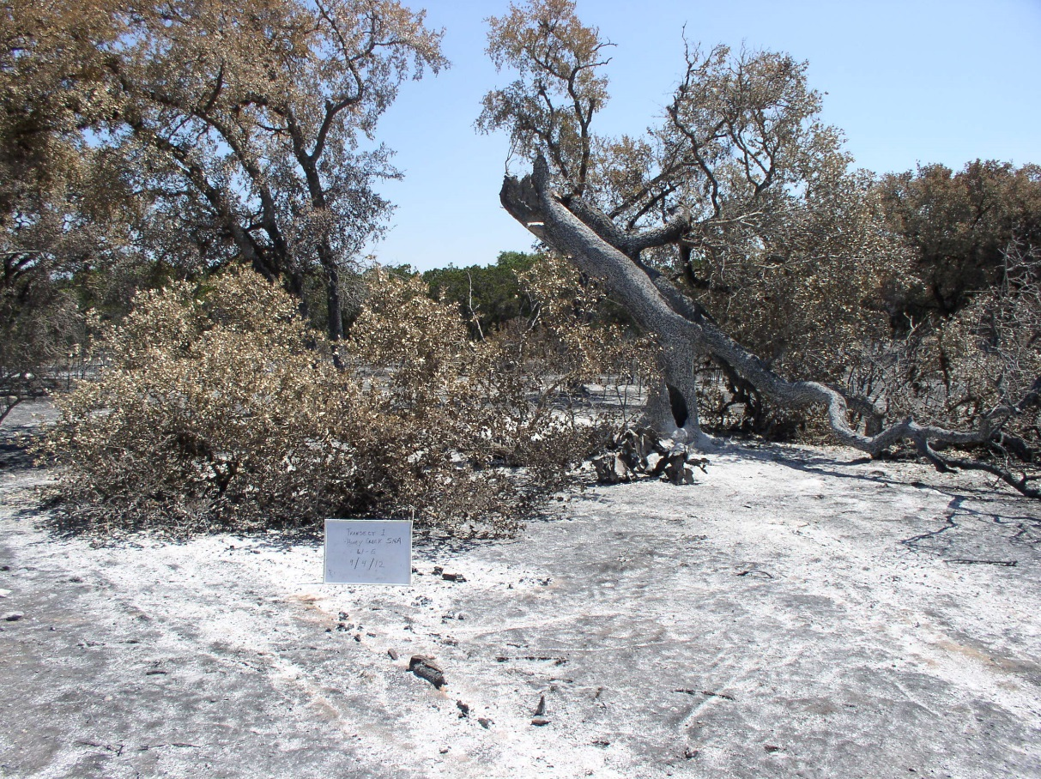
Fire & Drought Impacts on Range Health
↓ Cover, Litter & OM
↓ Infiltration
↑ Runoff
↓ Soil Microbe

Slide 6
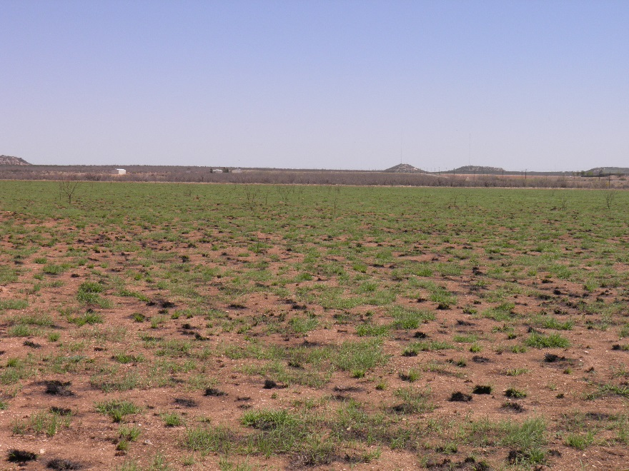
Re-Vegetation
Re-seeding Or Natural re-vegetation from Seed Bank
Succession
Pioneer Species (weeds)
Provide soil cover and
organic matter
Perennial grasses and forbs
Brush and Trees

Slide 7
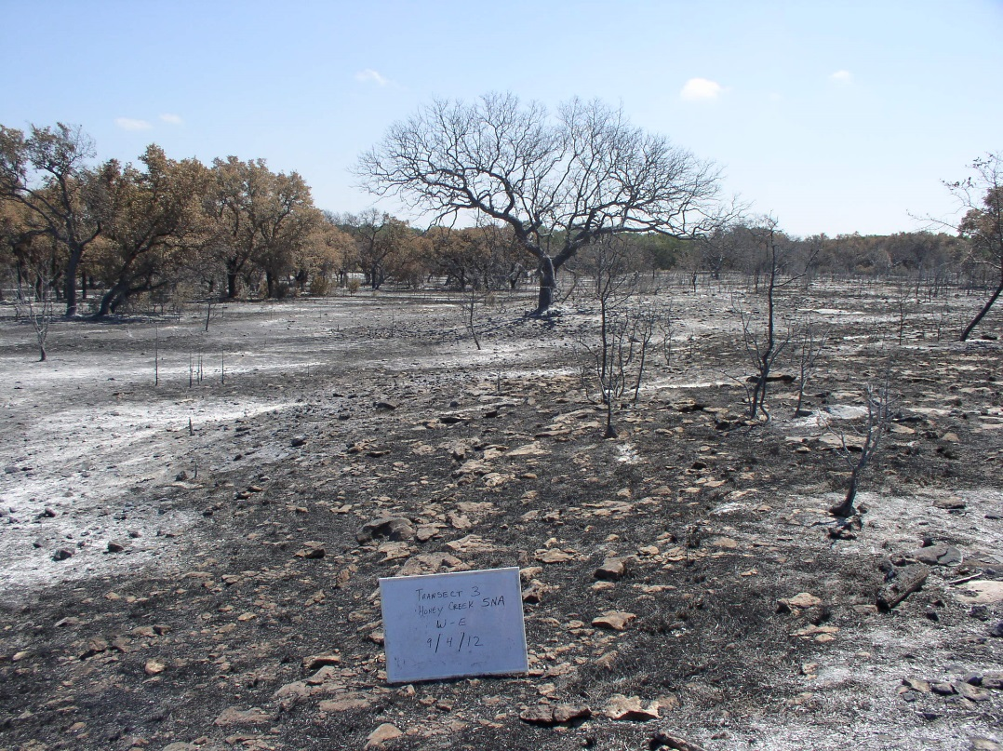
Grazing Management
The land must be given time to recover
Any grazing is too
much grazing!
Remove Livestock
Control Wildlife
Notes:
The plants are either starting from seed or trying to recover from stored carbohydrates. If drought continues they could also die. Any grazing is to much grazing! The new growth that is very desirable by wildlife. Deer and exotic numbers should be kept as low as possible.

Slide 8
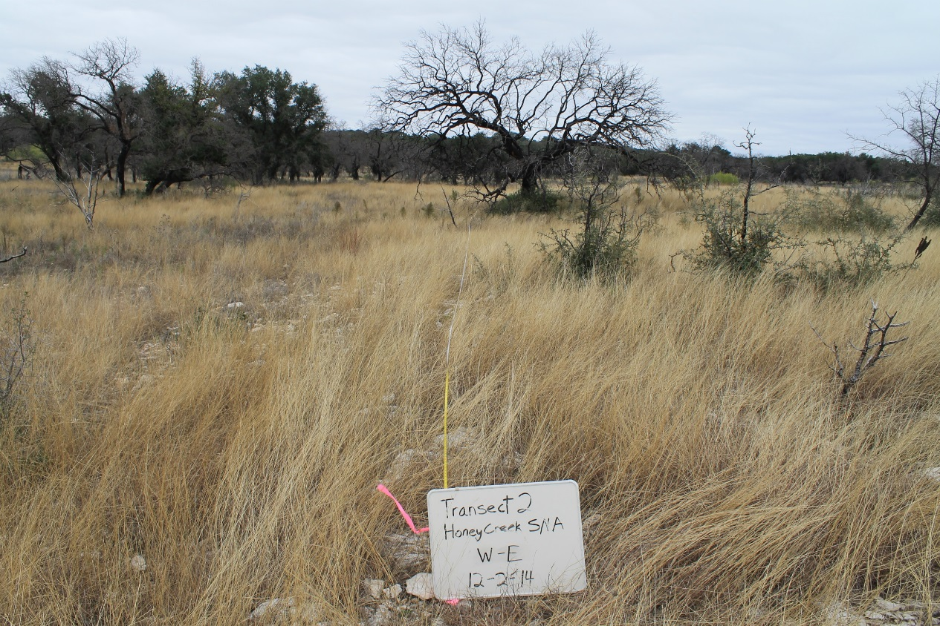
Grazing Management
How Long?
It depends!
Use monitoring
points
Consult with
others
You should have a good cover of perennial vegetation before re-introducing livestock

Slide 9
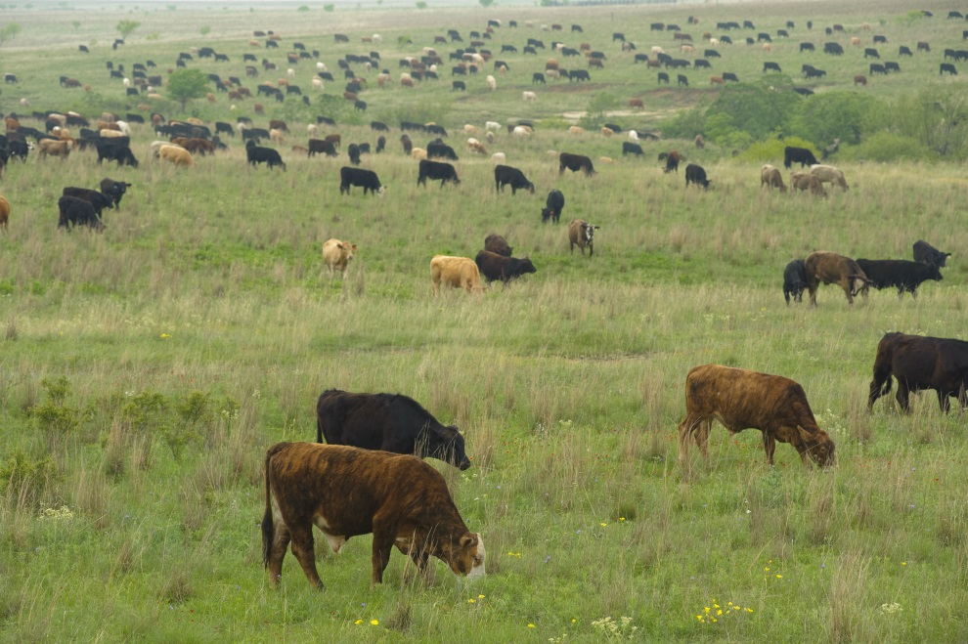
#1 Key Grazing Management Decision
Stocking Rate
Forage demand cannot exceed forage supply!

Slide 10
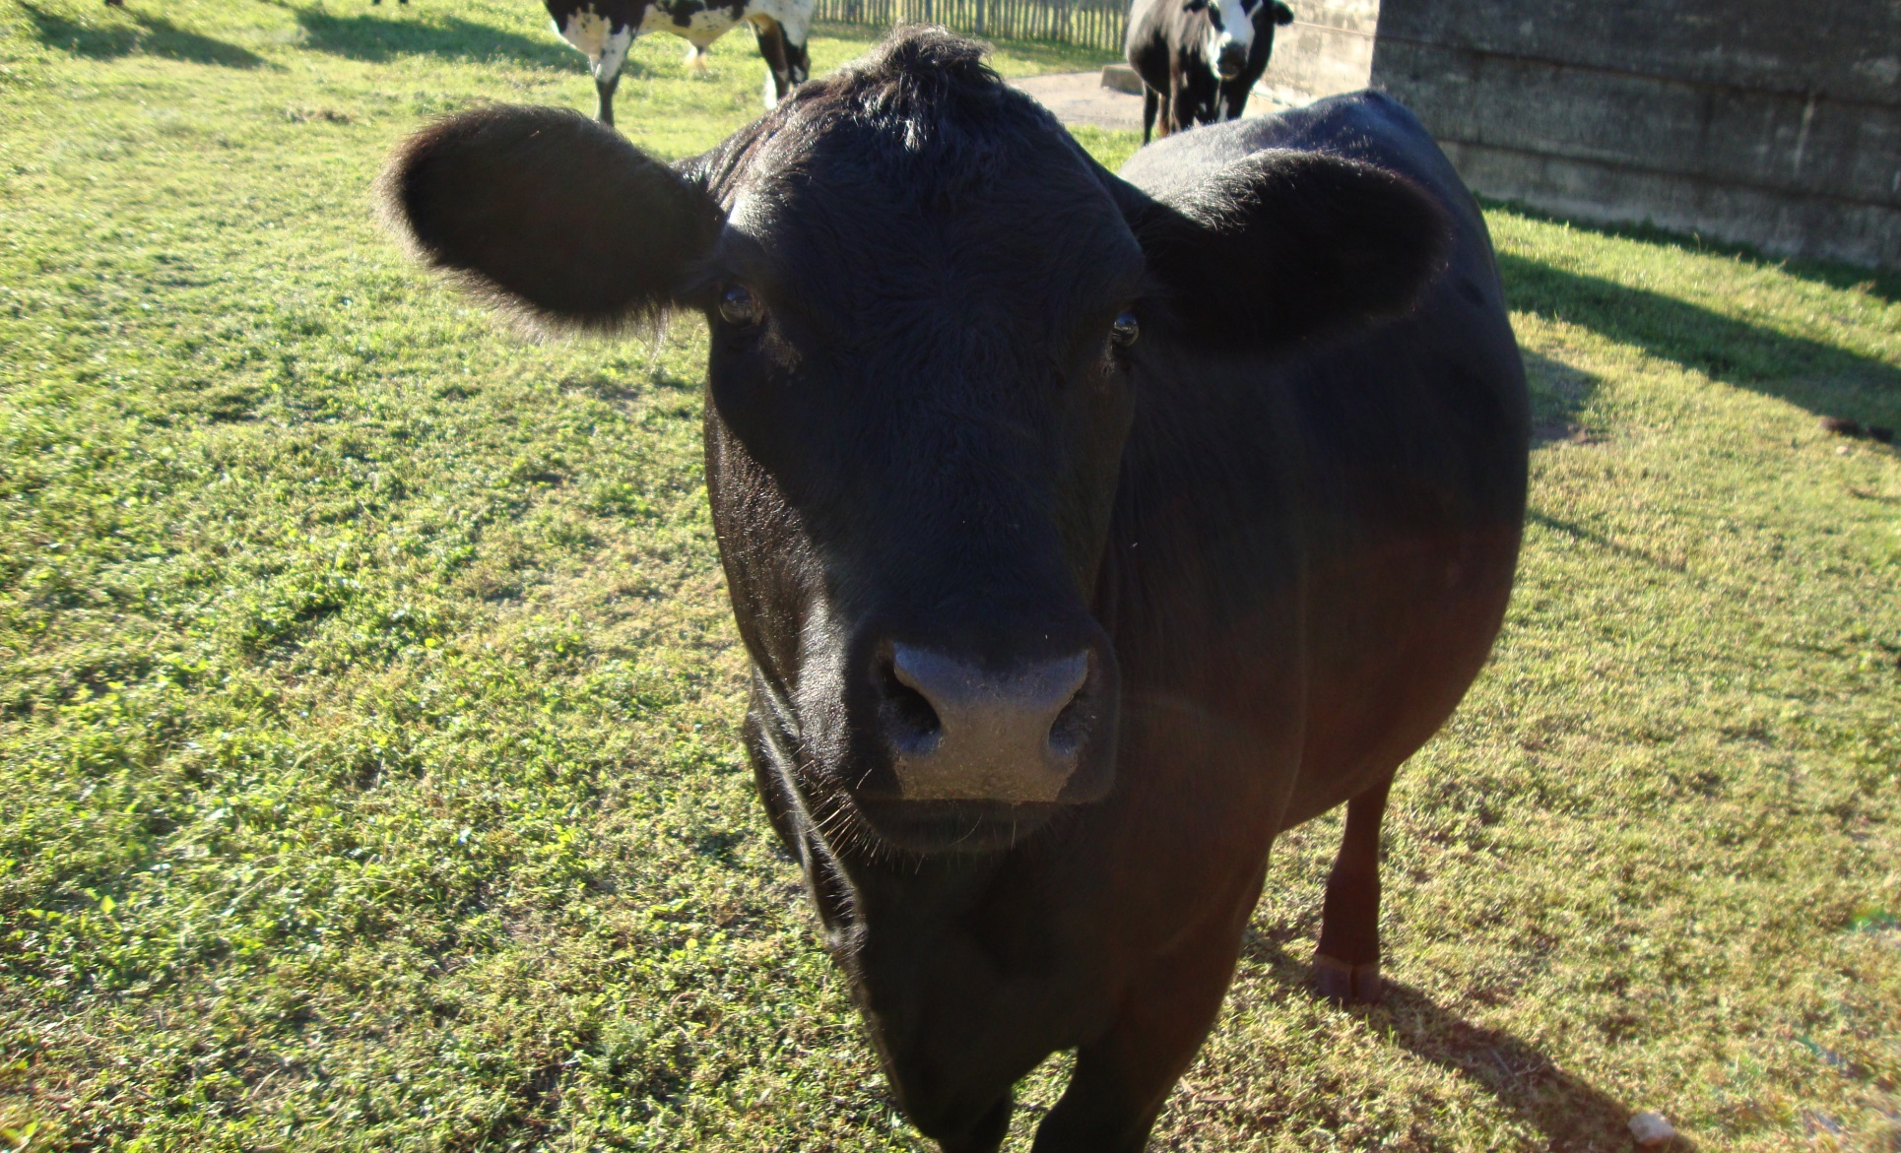
That’s All Folks!
USDA is an equal opportunity provider and employer.

